Slide 1
Module 8 Portfolio Project Oral and PowerPoint Presentation - Netflix
Brooke Dietrich
Colorado State University Global
MIS581: Capstone: Business Intelligence and Data Analytics
Doctor Steve Chung
May 14, 2023

Slide 2
Netflix’s Successful Innovation
1998
1999
2000
2007
2013
Disrupted the DVD market by providing an at home mailing system
Began a subscription service
Started creating Algorithms to help gage what the customer is watching
Introduced streaming
Started creating their own movies and TV shows
Netflix has since gained a wide market share and transformed into an online platform
Notes:
Netflix disrupted the DVD market by providing an at home mailing system. Their business model was created around distributing DVDs to households everywhere. In 1999, Netflix started their subscription service where customers could have an unlimited number of rentals per month. In 2000, Netflix premiered its recommendation software. “After each rental, Netflix asks viewers to rate the movie on a five-star system, and CineMatch looks for clusters of viewers who rat films in similar ways” (Osur, 2016). These algorithms could help to customize the customer experience. Eventually, the algorithms were used to predict the movies customers would choose to watch in the future. This would aid Netflix in recommending specific movies or TV shows to their customers to help with customer retention as well as help them select which TV shows and movies would be best to market. In 2007, Netflix introduced streaming TV. This meant that the customer no longer had to wait to have a DVD sent to their house, but they could now stream it instantly from home. In order to differentiate themselves and continue to retain customers, Netflix began creating their own content. They would continue to outsource TV shows and movies, but they also began creating content that was only available with a Netflix subscription.

Slide 3
Problem Statement
The company has adapted its business strategy to meet the changing demands of the market
They need to adapt their strategy to stay ahead of their competitors
The overall goal is to determine whether Netflix can offer “more” to their customers for “less” by examining the relationships between different variables of Netflix content to see if they have an affect on one another and therefore affect Netflix’s profit and subscription rate.
Notes:
Although Netflix has found a niche in the market and has continued to adapt to the changing technological advancements, they face the problem of competition. Netflix needs to determine how to stay ahead in the market by establishing long-term relationships with their customers. The overall goal is to determine whether Netflix can offer “more” to their customers for “less” by examining the relationships between different variables of Netflix content to see if they have an affect on one another and therefore affect Netflix’s profit and subscription rate.

Slide 4

Goals and Objectives
Summarize streaming data that Netflix has available on its platform, so that recommendations can be made on how Netflix can continue to build its brand and customer basis
The goal is to understand the how Netflix can maintain subscriber relationships.
Notes:
In order to determine how the affect the variables within Netflix’s platform change their subscription and revenue basis, I examined a Netflix dataset. I wanted to be able to determine if viewers preferred TV shows or movies more than the other. I also wanted to examine the other variables within the dataset including the most popular release year, the ratings and durations of the TV shows and movies, and the different types of categories they fall into. The goal of this analysis was to determine if the different variables had any correlation with one another. If Netflix can better understand the types of TV shows and movies, they have available on their platform, they can better utilize data analytics to market these TV shows and movies to specific customers.

Slide 5
Overview of the Study
“Most streaming platforms provide users with access to vast repositories of content with only a small fraction familiar to them” (Lamkhede et al., 2019).
“Interestingly, even with fragmentation of the television audience across niche channels and the shift to widespread consumption of time-shifted content, viewers continue to derive a sense of participatory cultural citizenship from TV” (Matrix, 2014).
Notes:
Advancements in technology now allow subscribers to watch TV shows and movies from anywhere. They can quickly and easily pull up a downloaded movie while on an airplane or while on a family vacation. “This motivates the market players to innovate, develop their products, and provide better service to its customers in order to survive the competition” (Oat, 2013). If Netflix can stay one step ahead of their competitors, they will stay successful. I analyzed the relationships between the variables within Netflix’s streaming content to better understand the correlation between the variables. Understanding the relationships between the variables can give Netflix an advantage when marketing TV shows and movies to their subscribers. It allows the company to better understand their content and how it relates to their customers.

Slide 6
Research Questions
The research questions that will be aimed to answer include:
1
Are more TV shows or movies provided on the platform?
2
Is the date added dependent upon the release year of the TV show or movie?
3
What rating does the most TV shows and movies fall into?
Notes:
To solve the problem statement, I formed three research questions. These include: Are more TV shows or movies provided on the platform?, is the date added dependent upon the release year of the TV show or movie?, and what rating does the most TV shows and movies fall into? When analyzing the Netflix dataset, it is crucial to determine the importance of each of the variables. If the company can gather intel into these research questions, they can better understand the products they have available on their platform. This will help them to market their TV shows and movies to specific customers to increase customer satisfaction, and it will also help them in content creation to produce successful shows on their platform.

Slide 7

Methodology
The Netflix dataset provides data on over eight thousand TV shows and movies that can be streamed on Netflix
A quantitative approach was used to analyze the dataset
Notes:
Overall, the dataset provides information on a list of TV shows and movies that Netflix subscribers have access to. The Netflix dataset provides data on over eight thousand TV shows and movies that can be streamed on Netflix, and a quantitative approach was used to analyzed the dataset. Analysis was performed to analyze the relationships between the variables to understand how the company can use this information to maintain customer relationships as well as build new ones.

Slide 8
Methods
SAS Studio was utilized to perform the summary statistics analysis on the Netflix dataset. The summary statistics will give an overall view of the variables the author chooses to analyze.
Jupyter Notebook was used to create visualizations of the frequency of variables to help to visualize the answers to the research questions.
SAS Studio was used to perform correlation analysis between the variables in the Netflix dataset. This analysis will determine if there is a high correlation between variables within the dataset, which can show how reliable the variables are on one another.
Linear regression along with a t-test evaluation was used to analyze the relationship between the variables in the Netflix dataset.
Notes:
To perform the analysis, I used various methods. “Descriptive statistics are used to summarize data in an organized manner by describing the relationship between variables in a sample or population” (Kaur et al., 2018).
Predictive analytics is an “analytics technique that uses statistical methodologies and forecasting to know what will likely to happen in the future” (Roy et al., 2022). SAS Studio was used to gather summary statistics on the dataset as well as perform correlation analysis, linear regression, and t-test evaluation. Jupyter Notebook was used to create visualizations.

Slide 9


Limitations
It is difficult to gain access to Netflix’s data
and
All the data provided is only through 2021
Notes:
I ran into a few limitations while doing my research. It was difficult to gain access to Netflix data. I believe my research could be taken one step further if there was access to viewership data. Since I did not have access to Netflix’s viewership data, I made recommendations based on the data I do have, so that Netflix can apply the knowledge and research towards other data they may have. The data I was able to gather only provided data through 2021, and although this is recent, I would have preferred to have present day data as well.

Slide 10

Ethics
The data needs to be reliable and accurate because if inaccurate information is reported on TV shows and movies, this could cause producers to become upset.
When dealing with personal and sensitive information, it is important to be upfront and transparent.
It is important when dealing with personal information to be sure it is secure and safe and that customers are made aware of how their personal information is being used.
Notes:
When gathering data and doing research, there are ethics to consider. Anonymity and confidentiality is important when dealing with subscriber data. In this case, the collected data does not affect Netflix subscribers first-hand, but if the company wants to make internal changes, it will affect their subscribers. It is important when dealing with personal information to be sure it is secure and safe and that customers are made aware of how their personal information is being used. By providing transparency, the company can not only build customer trust, but they also shield themselves from legal issues.

Slide 11
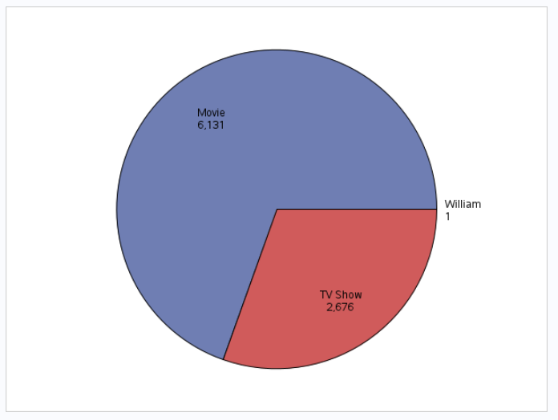
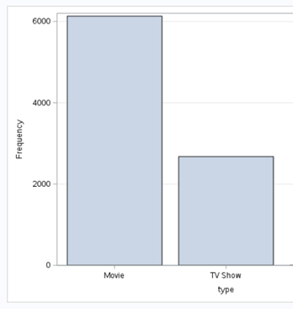
Findings
Figure 1 shows in the form of a bar graph that Netflix provides significantly more movies than TV shows
Figure 2 shows the data in a pie chart
Notes:
The null hypothesis stated that the number of TV shows and movies provided on the platform are equal. By analyzing Figure 1 and Figure 2, it was concluded that Netflix provides over two times the number of movies than TV shows. Therefore, you will reject the null hypothesis that the mean number of TV shows and movies provided on the platform are equal.

Slide 12
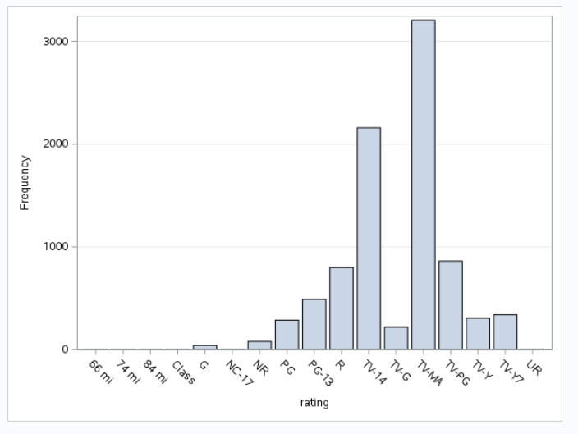
Findings
Figure 3 shows the rating with the highest average number of TV shows and movies.
Notes:
The null hypothesis stated that the highest mean number of TV shows and movies do not fall into the TV-14 rating. According to the findings, the highest mean number of TV shows and movies fall into the TV-MA rating. Therefore, you will fail to reject the hypothesis that the highest mean number of TV shows and movies do not fall into the TV-14 rating.

Slide 13
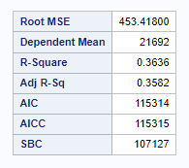


Findings
Figure 4
Figure 5
Figure 6
Notes:
I previously stated the null hypothesis that the date added to Netflix does not correlate with the release year of the TV show or movie. The correlation coefficient is the value of 0.17, which is shown in Figure 4. Since the value is close to zero, this indicates that little linear relationship exists between the two variables.
The R-Square value of 0.3636 indicates that the independent variable (the release year) is not explaining much of the variation of the dependent variable (the date added). This shows me that Netflix does not always add a TV show or movie to their platform the same year it is released, and therefore Netflix provides a lot of older content for its audiences.
Lastly, I performed a t-test for the date added variable. The p-value of <.0001 is less than the alpha of 0.05, which means that you will reject the null hypothesis.

Slide 14
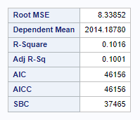
Findings
Figure 7
Notes:
I analyzed the R-Square value for the release year versus the rating of the TV show or movie. This is shown in Figure 7 below. The R-Square value of 0.1016 indicates that the independent variable does not explain much of the variation of the dependent variable.
These predictive statistics tests indicate that the two variables have little correlation between the two and therefore, you will fail to reject the null hypothesis that the date added to Netflix does not correlate with the release year of the TV show or movie.

Slide 15




Recommendations
Further analysis and questioning should be done by the Netflix team to determine the reasoning behind how they choose TV shows and movies for their platform.
Since Netflix offers the most content with a TV-MA rating, they should target this demographic specifically with subscriptions.
If attention spans of viewers are getting shorter, then Netflix should offer more TV shows on their platform since their duration is shorter.
Netflix as a company should determine if subscribers prefer newer content or older content.
Notes:
I recommend that Netflix does further analysis and questioning to determine the reasoning behind why specific TV shows and movies are chosen for their platform. Since it was difficult to gather viewership data, I recommend that Netflix uses this analysis in parallel to viewership data. Netflix as a company should determine if subscribers prefer newer content or older content, and since Netflix offers the most content with a TV-MA rating, they should target this demographic specifically with subscriptions. It is also important to consider that if attention spans of viewers are getting shorter, then Netflix should offer more TV shows on their platform since their duration is shorter. Netflix can utilize the findings to determine how to adapt their marketing strategy into the future. This can be done to increase subscription rates as well as revenue, and the more that Netflix can understand about the content they have available on their platform, the better they can maintain customer satisfaction rates.

Slide 16
Conclusion
If Netflix can better understand the TV shows and movies and the relationships between the variables, then they can better market them and understand what content to provide next.
Not only can Netflix gain new subscribers by offering unique content, but they can make sure the right people are watching the right content to maintain customer satisfaction in the long run.
Notes:
If Netflix can better understand the TV shows and movies and the relationships between the variables, then they can better market them and understand what content to provide next. Analysis was performed on the Netflix dataset to determine the relationships between the variables. Not only can Netflix gain new subscribers by offering unique content, but they can make sure the right people are watching the right content to maintain customer satisfaction in the long run. Netflix can use this data along with viewership data to bring more insight into how the company runs their marketing strategies and in turn bring in more customers and more revenue in the long run.

Slide 17
References
Kaur, P., Stoltzful, J., & Yellapu, V. (2018). Descriptive Statistics. International Journal of Academic Medicine.
Lamkhede, S. & Das, S. (2019). Challenges in Search on Streaming Services: Netflix Case Study Proceedings of
the 42nd International ACM SIGIR Conference on Research and Development Retrieval.
Matrix, S. (2014). The Netflix Effect: Teens, Bing Watching, and On-Demand Digital Marketing Trends.
Jeunesse: Young People, Texts, Cultures 119-138.
Oat, E. (2013). Analysis of Netflix Architecture and Business Model. Dostupno
Osur, L. (2016). Netflix and the Development of the Internet Television Network. Surface.
Roy, D., Srivastava, R., Jat, M., & Karaca, M.S. (2022). A Complete Overview of Analytics Techniques:
Descriptive, Predictive, and Prescriptive. Decision Intelligence Analytics and The Implementation of
Strategic Business Management 15-30.

